Slide 1

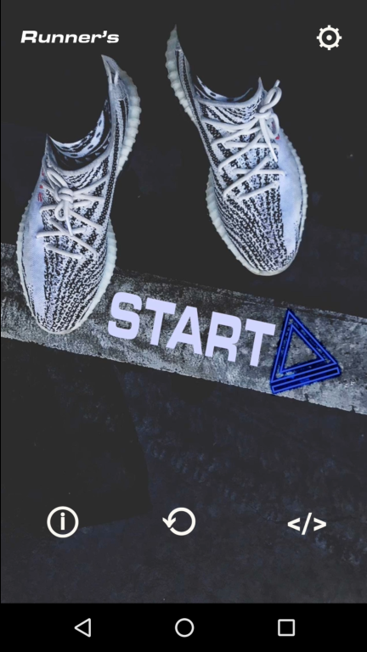
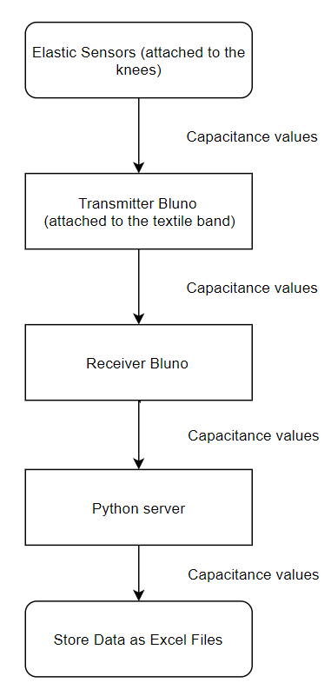
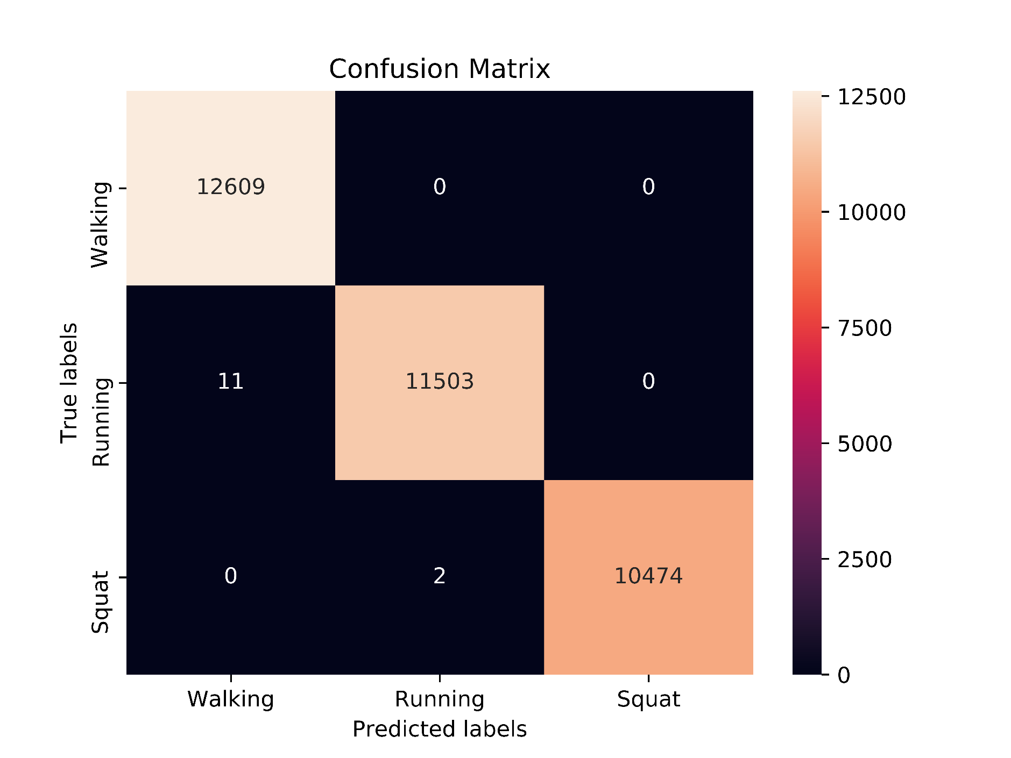
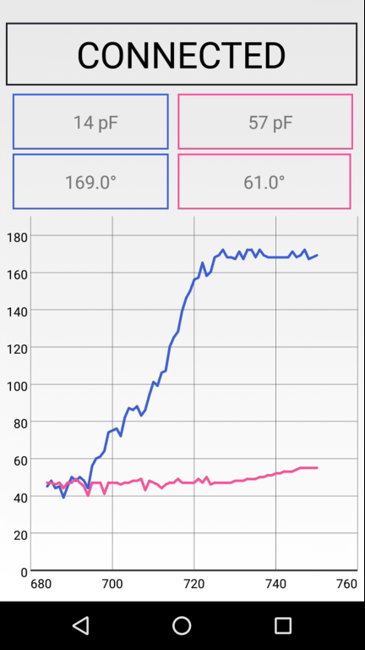
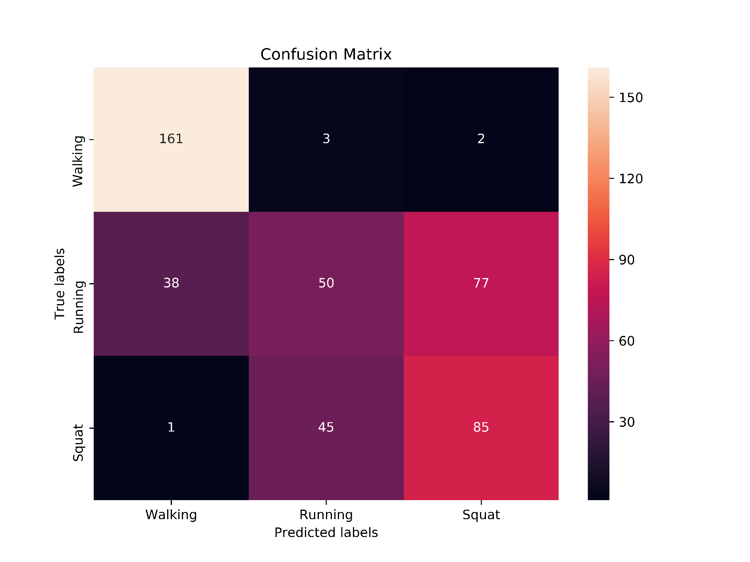
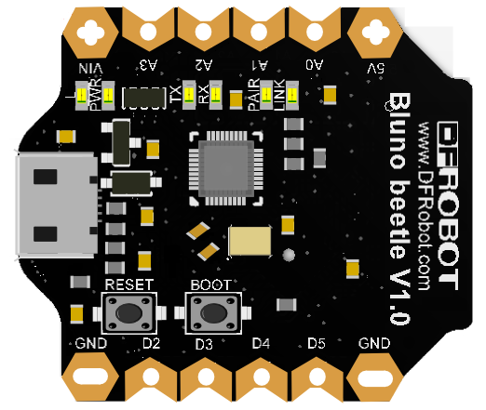
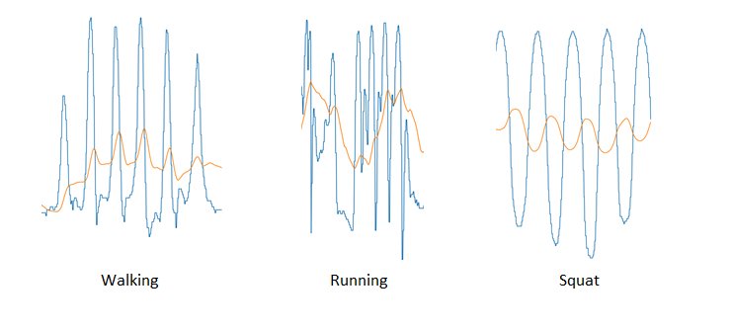
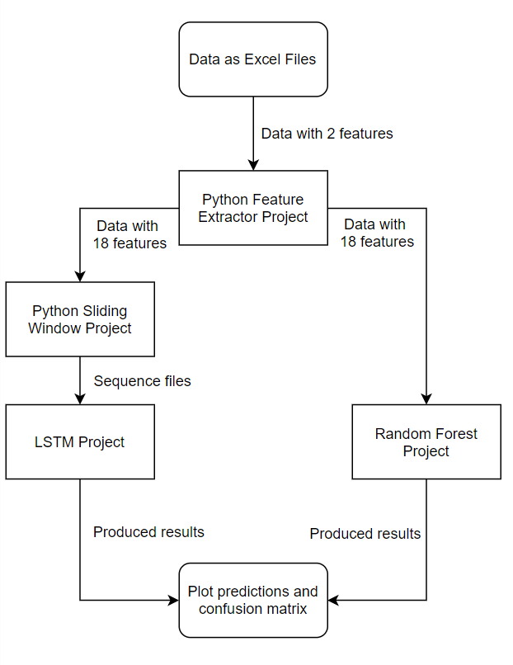
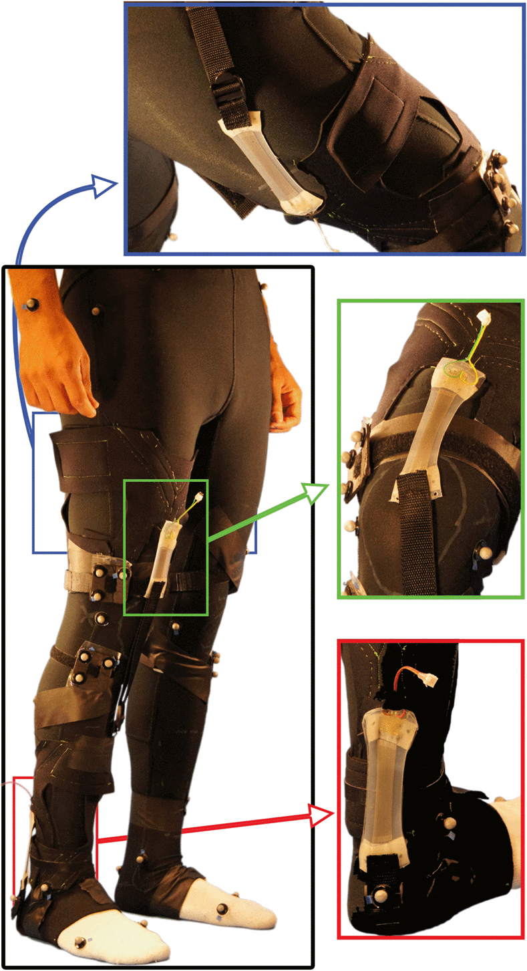
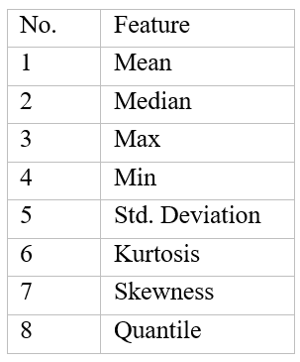
Activity Recognition
Using E-Textile Sensors
Hakan ERÖZTEKİN
Consultant: Assoc. Prof. Gökhan İNCE Istanbul Technical University – Department of Computer Engineering
SUMMARY
METHODOLOGY
RESULTS
Advances in the Internet of Things (IoT) technology have established a mean for widespread usage. Popular examples include smart watches and smart home systems. Also, one of the most promising part of the technology is wearable smart sensors. These devices are pocket-sized, can communicate with other devices, and are wearable as the name suggested. These features provided huge possibilities. Heart-rate of people with heart diseases can be tracked and the nearest ambulance can be in milliseconds, in an automated way. Athletes’ sports performance can be tracked in real-time.
The major problem is on inferring a meaningful results from the information collected from the sensors. Using the sensors, all the movements of the joints can be tracked. However, recognition of movements and distinguishing one from the other is a challenge.
In the project, the approach is on applying machine learning and deep learning algorithms to recognize the movement correctly.
Using the Random Forest approach, 99.9% accuracy is achieved. To prevent possible overfitting, model is adjusted and 95% accuracy is acquired.
The project is a work with multiple aspects: data collection, data preprocessing, model training and data visualization.
Figure 8: Random Forest Confusion Matrix
Figure 2: Model prototype
The LSTM model produced 64% accuracy.
To start the measurement elastic sensors are attached to the knees. The sensors measure the capacitance values that vary during the knee movements. Through Bluno, an Arduino UNO-like device with Bluetooth feature, the measurement values are transferred to computer and saved as excel files.
TRIFOLD AREA – THIS GUIDE WILL BE REMOVED BEFORE PRINTING – TRIFOLD AREA – THIS GUIDE WILL BE REMOVED BEFORE PRINTING – TRIFOLD AREA – THIS GUIDE WILL BE REMOVED BEFORE PRINTING – TRIFOLD AREA – THIS GUIDE WILL BE REMOVED BEFORE PRINTING – TRIFOLD
TRIFOLD AREA – THIS GUIDE WILL BE REMOVED BEFORE PRINTING – TRIFOLD AREA – THIS GUIDE WILL BE REMOVED BEFORE PRINTING – TRIFOLD AREA – THIS GUIDE WILL BE REMOVED BEFORE PRINTING – TRIFOLD AREA – THIS GUIDE WILL BE REMOVED BEFORE PRINTING – TRIFOLD
INTRODUCTION
The project is an endeavor to recognize human activities correctly. There are 3 movements; movement, walking and squat. As it can be seen, each movement has its own characteristics but is also has a repetitive pattern.
Figure 3: Data Collection
Figure 4: Bluno
The excel files only have two features (columns of data) left and right knee capacitance values.
Using Feature Extraction Project, developed during the project, 8 more features are extracted for each leg using rolling window approach. Thus, data with 18 features is acquired.
Figure 5: Mobile application for data collection and visualization
Figure 9: LSTM Confusion Matrix
FUTURE RESEARCH
The project outshines for its scalability. It can be used to recognize many more activities, even the heart movements when the data is provided.
Thus, in near future, the project would be useful to recognize heart-rate anomalies in the people with heart diseases, detect accidents (like falling from the stairs) in the elderly people who live alone to inform the nearest hospital and track gym performance metrics of athletes and give feedback for improvements.
Figure 1: Movement patterns
Then the data is split for train and test parts and used on the Random Forest model.
In addition to that, for LSTM, data is transformed to a time series problem. For that, sliding window protocol is used with 2-second window size and 50% overlap between each window.
After, the data is used in the LSTM model.
For the movement classification problem, Long Short Term Memory (LSTM) and Random Forest algorithms are selected.
Figure 10: A prototype with six sensors
Figure 7: Extracted Features
ACKNOWLEDGEMENTS
I would like to give special thanks to my advisor Assoc. Prof. Gökhan İNCE. I want to thank Dr. Özgür ATALAY, Uğur AYVAZ and Kadir ÖZLEM for their support during the project. I also want to express my gratitude to my colleague Orçun ÖZDEMİR for his backup for the machine learning. Lastly, I am grateful for my faculty, university and also all my family.
Figure 6: Model training

